Slide 1

SONG RECOMMENDER USING FACIAL EXPRESSION
Internal Guide: Mr. Babu
Name of the Student: Master HARIHARAN B P
Register Number: 39110373

Slide 2
Presentation Outline
Project Team
Introduction
Objectives
Ideation Map
Project Implementation
Application Snapshots
Results and Discussions
Conclusion & Future work
References

Slide 3
Project Team
As we have taken option 1, and we are a team of 3 members,
JAGADEESH. N (39110393)
MOHNISH DEVARAJ (39110636)
HARIHARAN B P (39110373)
So, we have taken our own project and we are working under the guidance of Dr. Albert J Mayan M.E., Ph.D.,
We have taken this as our final project as this is a big project and new app for the android platforms.

Slide 4
Introduction
“SONG RECOMMEDER SYSTEM USING EMOTION DETECTION” is an Android Application where a user will be able to play songs according to their mood(emotion).
This application lets the user to select the language and using emotional recognition.
“SONG” a well-known and very meaningful word, which is the one-stop you will go to calm your mind and all the surroundings will be gone when you dive into this virtual world full of your favorite songs.
Music plays an important role in an individual’s life. It is an important source of entertainment and is often associated with a therapeutic role.
With the Advent of technology and continuous Advancements in multimedia, sophisticated music players have been.
As we all know, human emotion played a vital role in recent times and will play in coming future.
To overcome these scenarios this idea has been developed and also is the objective of this idea.

Slide 5
Objectives
“SONG RECOMMEDER SYSTEM USING EMOTION DETECTION” is an Android Application where a user will be able to play songs according to their mood(emotion). This application lets the user to select the language and using emotional recognition.
The objective of the project is to extract feature from human face and detect emotion and play music according to the emotion detected. Facial expressions are captured locally using a camera device. Then the facial structures are compared and the songs are played based on what the emotion is.

Slide 6
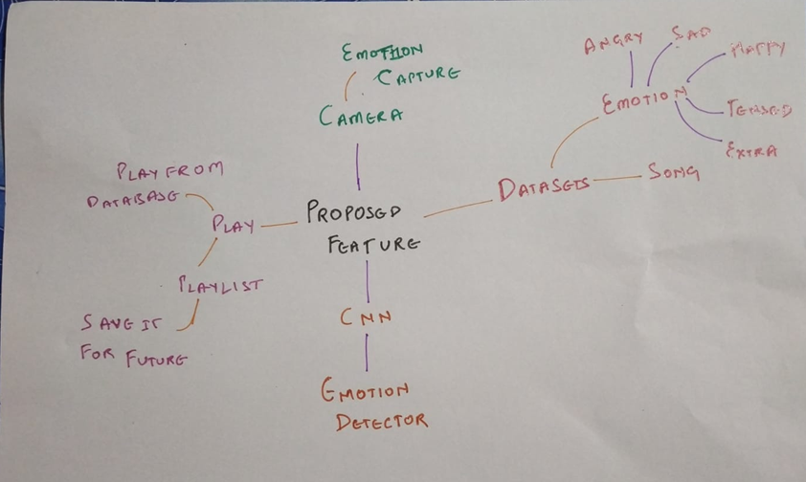
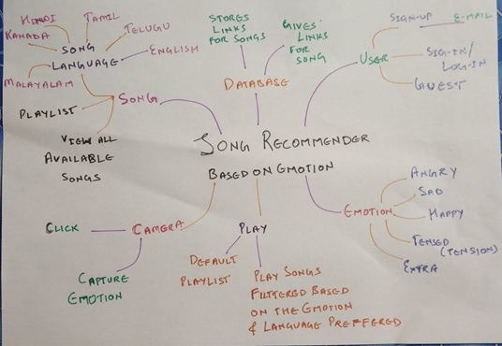
Ideation Map

Slide 7
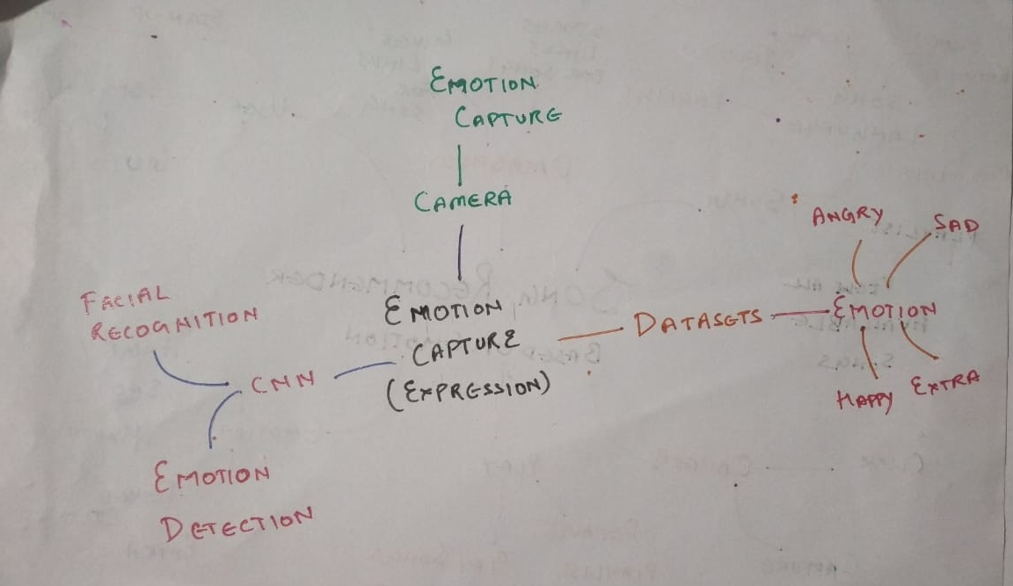
Ideation Map

Slide 8
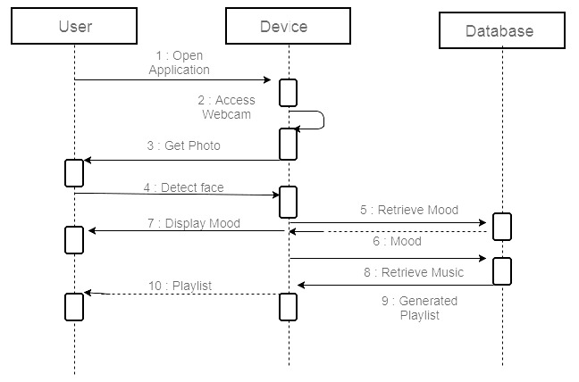
Project Implementation
We used algorithms like CNN (Convolution Neural Network), HaarCascade, MobileNet.
Optimization algorithms such as, RMS-Prop (Root Mean Square Propagation), Adam (Adaptive Moment Estimation).
Training error is the error that you get when you run the trained model back on the training data.
Test error is the error you get when you run the trained model on a set of data that it has previously never been exposed to.
In optimization we used Early Stopping and Loss Function.

Slide 9
Project Implementation
In this project, by running the main it will trigger an XML file that then OpenCV helps in capturing images from the webcam as well as for processing purposes.
We have made the implementation of the CNN along with OpenCV and TensorFlow for classification.
MobileNet using ImageNet to train the model and store it in a model-file (XML).
In this, the app contains 2 options one for emotion-based detection and the other for random selection of song.
The 3 main processes are capturing, detection and playing of the music.
This system, describes the facial expressions using detection and combination of spatial expressions.
After Feature Extraction, the Emotions are classified into different forms I.e., Happy, Angry, Sad and neutral face, etc.
The emotions that are transferred to last step are in numerical form and the music is played from the emotions that are detected.

Slide 10
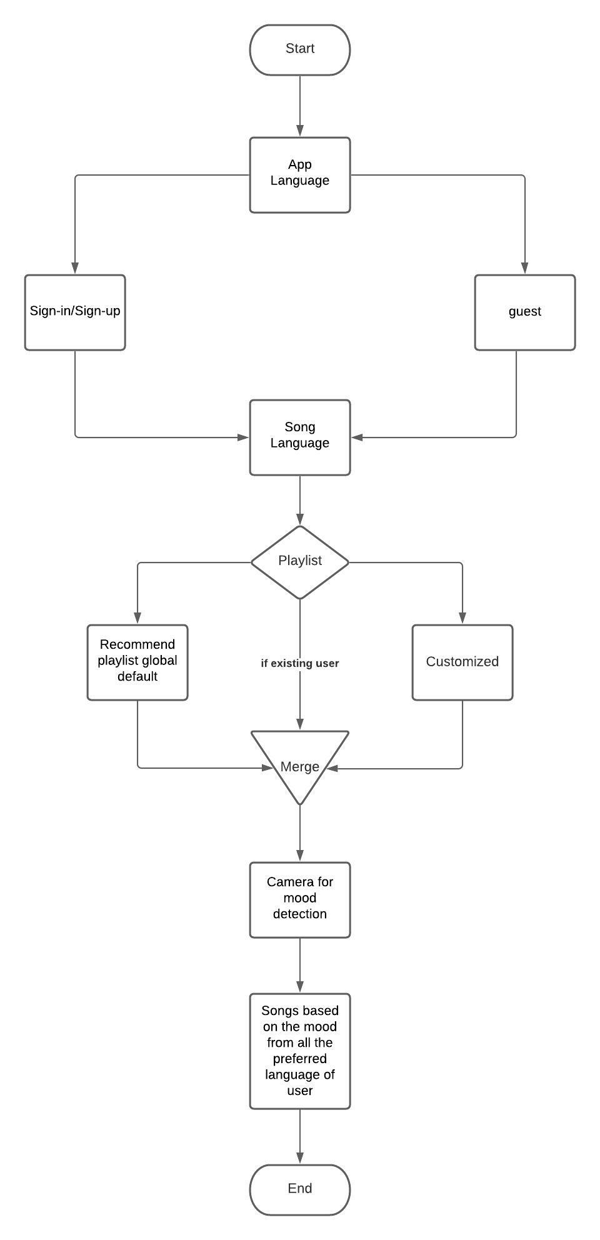
Project Implementation
Step 1: The user gives input, which is in the form of the image captured using the camera.
Step 2: The image gets analysed by our model and gets classified as a happy, sad, neutral or angry emotion.
Step 3: The data gets extracted and detected with the training datasets, which are fer-13 datasets.
Step 4: The playlist or songs are chosen according to the facial mood recognition of the user.
Step 5: The music gets played to boost the user’s mood after successful detection of the sentiments

Slide 11
Project Implementation
HARDWARE REQUIREMENTS:
1) ANDRIOD DEVICE/EMULATOR
2) Android 8 or more.
3) Min of 4GB RAM in device.
SOFTWARE REQUIREMENTS:
1) VSCode/Android Studio for making any development changes
2) Flutter SDK 2.5 or more.

Slide 12
Application Screenshots

Slide 13
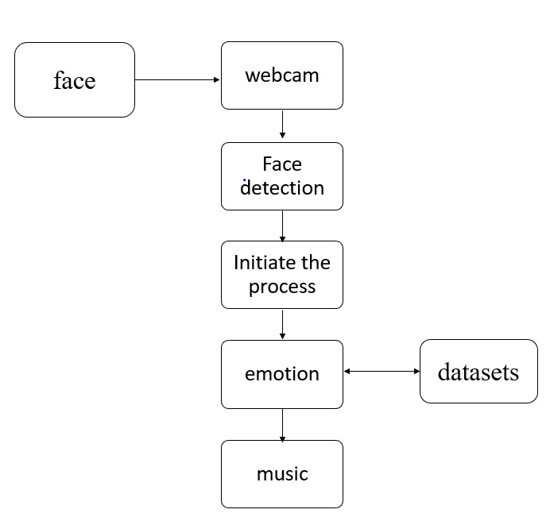
Methodology
Facial Detection — Ability to detect the location of face in any input image or frame.
Facial Recognition — Compare multiple faces together to identify which faces belong to the same person.
Emotion Detection — Classifying the emotion on the face as happy, angry, sad, neutral and surprise.
Methods like TRANFER LEARNING, DATA AUGMENTATION, BATCH NORMALIZATION are also used.
We also used LOSS CATEGORICAL CROSS ENTROPY which means Cross-entropy builds upon the idea of entropy from information theory.

Slide 14
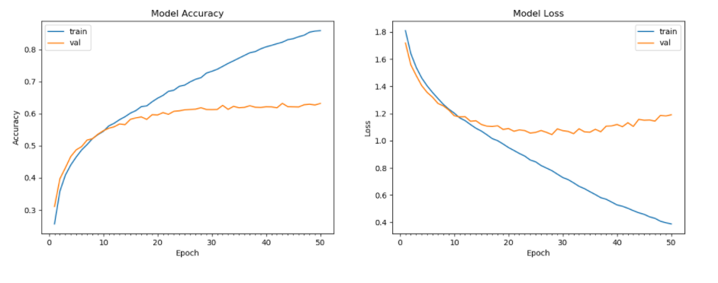
Results and Discussion

Slide 15
Results and Discussion
This implementation by default detects emotions on all faces in the webcam feed. With a simple 4-layer CNN, the test accuracy reached 63.2% in 50 epochs.
The original FER2013 dataset in Kaggle is available as a single csv file. It has been converted into a dataset of images in the PNG format for training/testing and provided this as the dataset.
It is one of the more challenging datasets with human-level accuracy only at 65±5% and the highest performing published works achieving 75.2% test accuracy. Easily downloadable on Kaggle, the dataset’s 35,887 contained images are normalized to 224,224 pixels in grayscale. FER2013 is, however, not a balanced dataset
Model — we built a 5 layered Convolutional Neural Network (CNN) in Keras and used Image augmentations, transfer learning, data augmentation, batch normalization and optimization algo to improve model performance.
Epoch is when an ENTIRE dataset is passed forward and backward through the neural network only ONCE. So, the ideal epochs for training a model is 25(minimum most cycle) here, we acquired the accuracy in 50 cycles. So, from the graph we can conclude that as the no. of cycles increases the accuracy increases and since the model is gaining knowledge as the cycle increases the model loss decreases.

Slide 16
Results and Discussion
Given the high complexity of transfer learning models and relatively small size of our datasets, we also experienced overfitting while training. Although we added 30% dropout for the last three layers, our ResNet transfer learning model quickly over fit to the training set with train accuracy starting to flatten after only 25 epochs.
The model consists of three stages of convolutional and max-pooling layers, followed by an FC layer and a softmax output layer. The convolutional layers use 32, 32, filters of size 5x5, 4x4, respectively.
The max-pooling layers use kernels of size 3x3 and stride 2.ReLU was utilized as the activation function. To improve performance, we also added batch norm at every layer and 30% dropout after the last FC layer.

Slide 17
Conclusion
This project has been developed to give us great advancement in the field of machine learning technology.
Emotion Based Music player fulfils to sort out the music based on the emotions of the user such as whether it is happy or sad.
So, totally our work aims to develop a player which is based on user need and it helps to revive in case of free time or leisure time if we want to hear music based on our current situation.
The front-end of the app is to be developed and will be submitted later.

Slide 18
References
[1] Spotify — Song Prediction and Recommendation System by : Sunku Sowmya Sree Source: https://medium.com/swlh/spotify-song-prediction-and-recommendation-system-b3bbc71398ad
[2] Create Music Recommendation System Using Python by : Ajinkya Khobragade Source: https://towardsdatascience.com/create-music-recommendation-system-using-python-ce5401317159
[3] Facial Recognition using OpenCV
by: Atul Balaji
Source: https://github.com/atulapra/Emotion-detection
[4] A Complete Guide to Adam and RMSprop Optimizer
By: Sanghvirajit
Source: https://medium.com/analytics-vidhya/a-complete-guide-to-adam-and-rmsprop-optimizer-75f4502d83be
[5] Dataset source
By: Kaggle website
Source: https://www.kaggle.com/c/challenges-in-representation-learning-facial-expression-recognition-challenge/data

